Slide 1




ASP.NET MVC Wrappers
Controls, Widgets, Grid…
SoftUni Team
Technical Trainers
Software University
http://softuni.bg

Slide 2





Table of Contents
IgniteUI ASP.NET MVC Wrappers Summary
Installation
IgniteUI Widgets
Grid
Data Visualization
Editors
Interactions
Other wrappers
KendoUI
DevExpress
MVC Controls Toolkit

Slide 3

IgniteUI
http://www.igniteui.com/

Slide 4
What is IgniteUI?
IgniteUI is HTML5/jQuery Controls and Tools
Responsive web design on:
any browser
any platform
any device

Slide 5
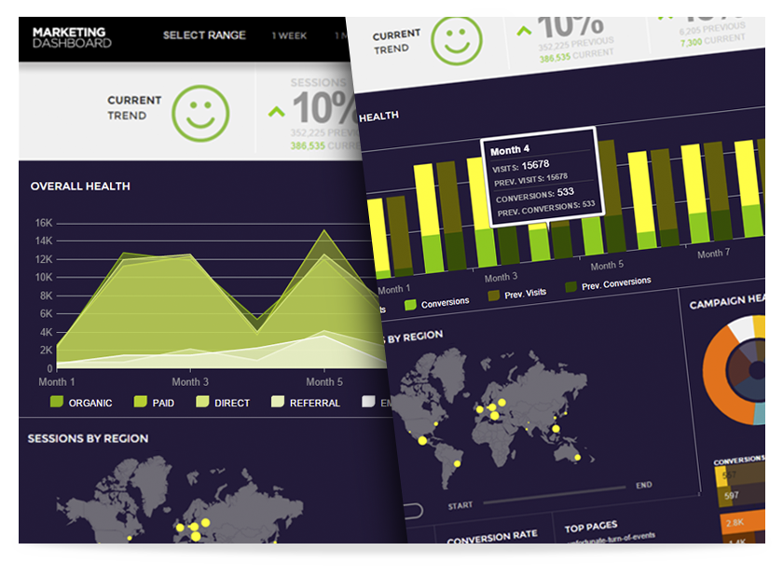
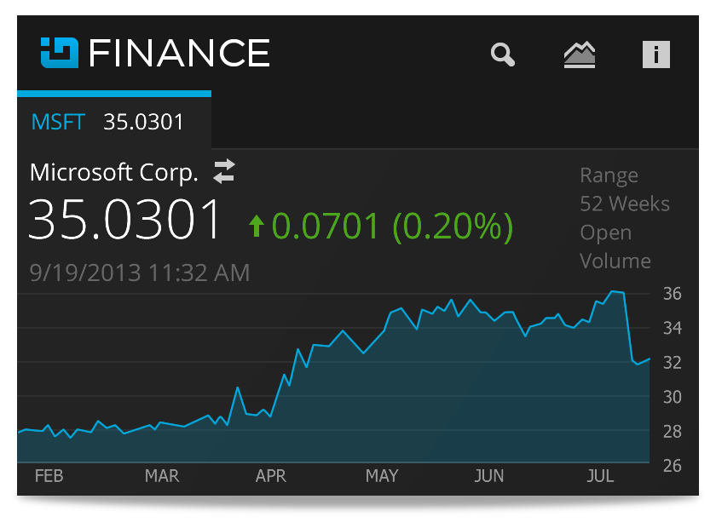
What give us IgniteUI?
Rich UI Widgets
Data Grids
Data Visualization
Layout
Editors
Frameworks
Interactions
Mobile Phone

Slide 6
How to install IgniteUI?
Download from http://www.infragistics.com/
Install Infragistics Platform (IgniteUI module)
Include dll files to your project
C:\Program Files (x86)\Infragistics\2015.1\Ignite UI\MVC\MVC5\Bin
Copy reference local
Include IgniteUI styles in head
C:\Program Files (x86)\Infragistics\2015.1\Ignite UI\css\structure\infragistics.css
C:\Program Files (x86)\Infragistics\2015.1\Ignite UI\css\themes\infragistics\infragistics.theme.css
Load jQuery and jQueryUI in head

Slide 7

How to install IgniteUI?
Include IgniteUI scripts in head
C:\Program Files (x86)\Infragistics\2015.1\Ignite UI\js\infragistics.core.js
C:\Program Files (x86)\Infragistics\2015.1\Ignite UI\js\infragistics.dv.js
C:\Program Files (x86)\Infragistics\2015.1\Ignite UI\js\infragistics.lob.js
Add namespace in Views Web.config file:
<add namespace="Infragistics.Web.Mvc"/>

Slide 8
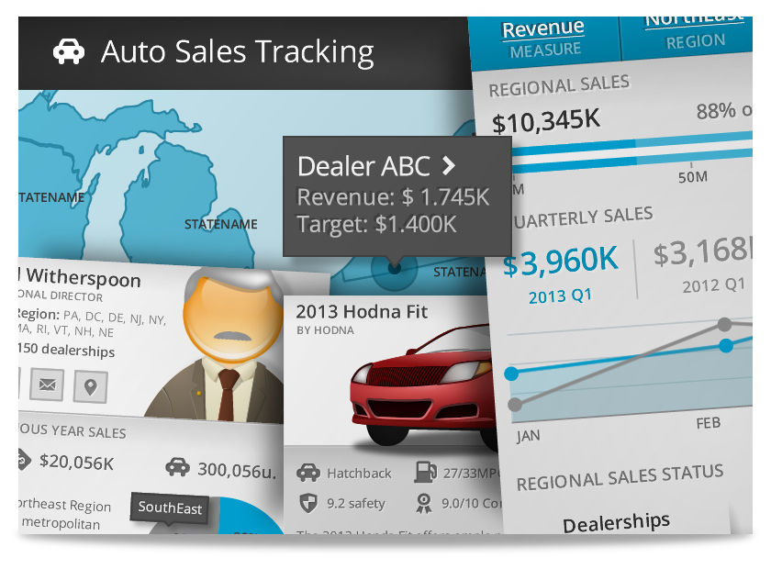
IgniteUI Widgets
ASP.NET MVC Helpers

Slide 9
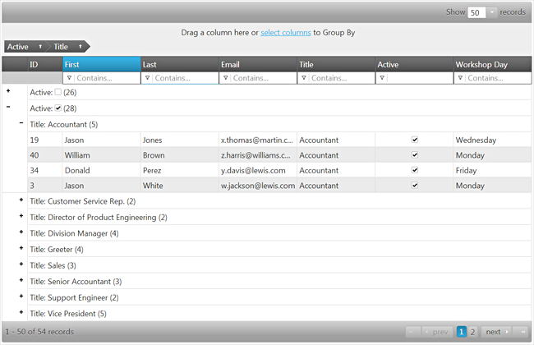
IgniteUI Grid

Slide 10
igGrid - Chaining
Controller
View
public ActionResult Users()
{
var users = this.Data.Users
.All()
.Select(UserViewModel.ViewModel);
return this.View(users);
}
Collection should be IQueryable
Collection should be IQueryable
@model IQueryable<UserViewModel>
@(Html.Infragistics().Grid(Model)
.DataBind()
.Render()
)

Slide 11
igGrid – Chaining with Settings
@(Html.Infragistics().Grid(Model)
.AutoGenerateColumns(false)
.Columns(column =>
{
column.For(x => x.Email);
column.For(x => x.Password);
})
.Features(feature =>
{
feature.Sorting().Mode(SortingMode.Multiple);
feature.Filtering().Mode(FilterMode.Simple);
feature.Paging().PageSize(5)
.PageSizeDropDownLabel("Page size:");
feature.GroupBy();
feature.ColumnMoving();
feature.Updating();
})
.DataBind()
.Render()
)
DataBind and Render are required!

Slide 12
igGrid - GridModel
Controller
View
public ActionResult Users()
{
var users = this.Data.Users
.All()
.Select(UserViewModel.ViewModel);
var model = new GridModel { DataSource = users };
return this.View(model);
}
DataSource should be IQueryable
@model UserViewModel
@(Html.Infragistics().Grid(Model))

Slide 13
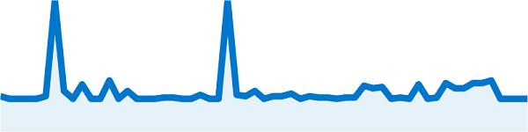


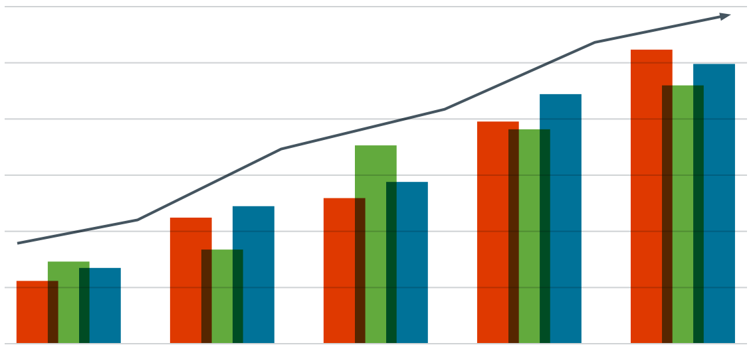
Data Visualization – Widgets
Pie Chart
Radial Gauge
Sparkline
Map
Barcode

Slide 14
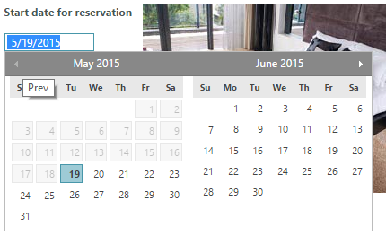
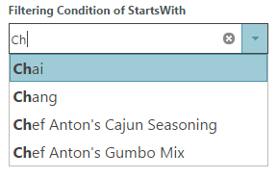
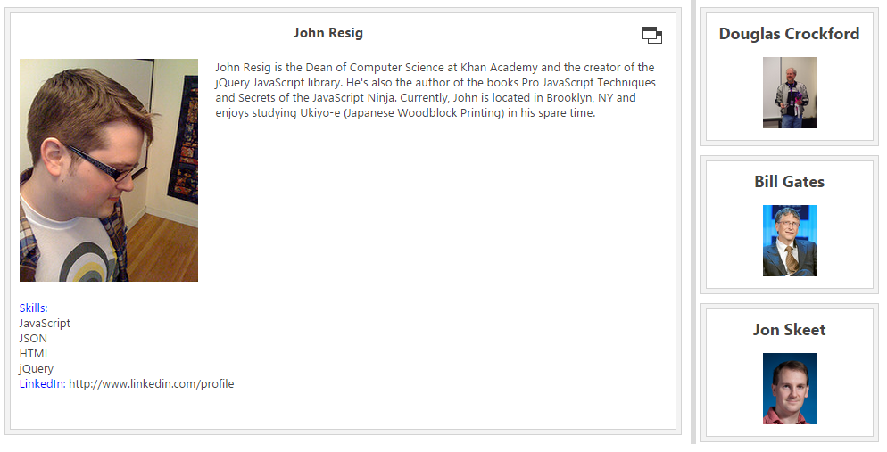
Other widgets
Editors
ComboBox
HTML Editor
Date Picker
Layout
Tile Manager
Splitter

Slide 15

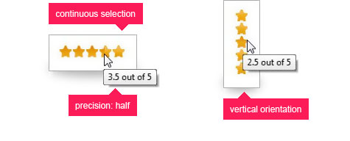
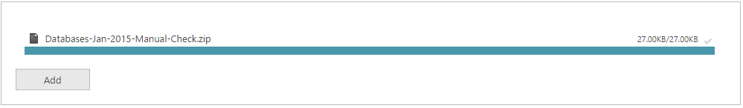
Interactions
Tree
Rating
Dialog Window
File Upload
Popover

Slide 16

KendoUI

Slide 17
KendoUI
Framework for building modern interactive web applications
Fast, light, complete
70+ jQuery-based UI widgets in one powerful toolset
AngularJS integration
Bootstrap support
Mobile controls
http://www.telerik.com/kendo-ui

Slide 18
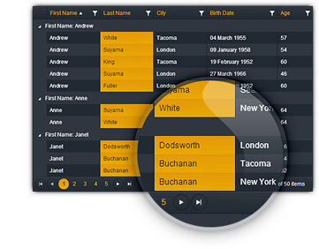
KendoUI Features
Rich UI Widgets
HTML5 controls based on jQuery Core
3 categories of UI Widgets
Web, DataViz and Mobile
Client-side DataSource
MVVM Framework
Animations and Drag & Drop
Server Wrappers
ASP.NET MVC
Java and PHP

Slide 19
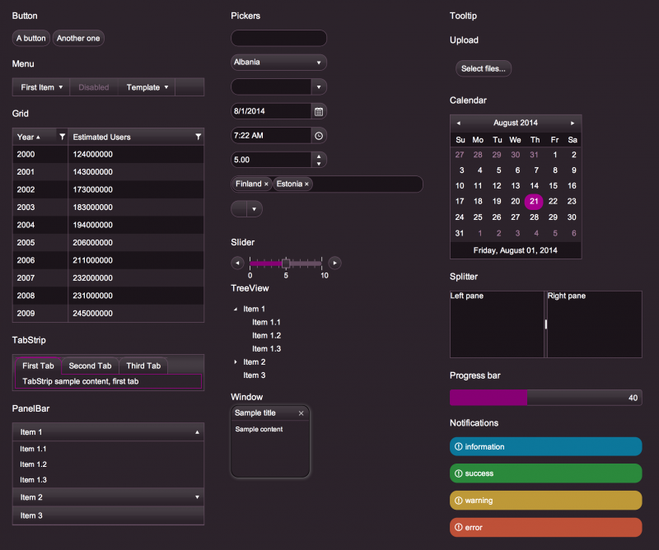
KendoUI Widgets
Web Widgets
Grid
AutoComplete
Calendar
DropDownList
Upload
TreeView
Data Visualization Widgets
Chart
LinearGauge
RadialGauge

Slide 20
KendoUI Installation
Download and install the platform
http://www.telerik.com/download/aspnet-mvc
Add reference to Kendo.Mvc.dll
C:\PF\Telerik\UI for ASP.NET MVC Q1 2015\wrappers\aspnetmvc\binaries\Mvc5
Add styles
C:\PF\Telerik\UI for ASP.NET MVC Q1 2015\styles\kendo.common.core.min.css
C:\PF\Telerik\UI for ASP.NET MVC Q1 2015\styles\kendo.common.min.css
Add scripts
C:\PF\Telerik\UI for ASP.NET MVC Q1 2015\scripts\jquery.min.js
C:\PF\Telerik\UI for ASP.NET MVC Q1 2015\scripts\kendo.all.min.js
C:\PF\Telerik\UI for ASP.NET MVC Q1 2015\scripts\kendo.aspnetmvc.min.js

Slide 21
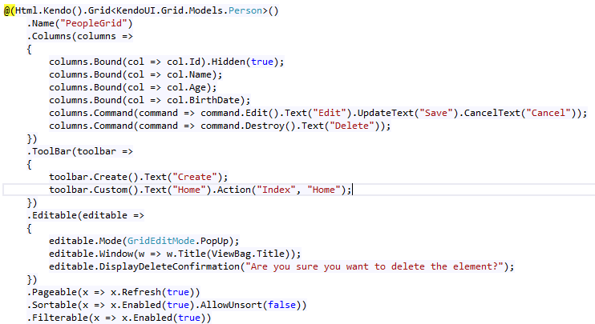
KendoUI Grid
Live Demo

Slide 22
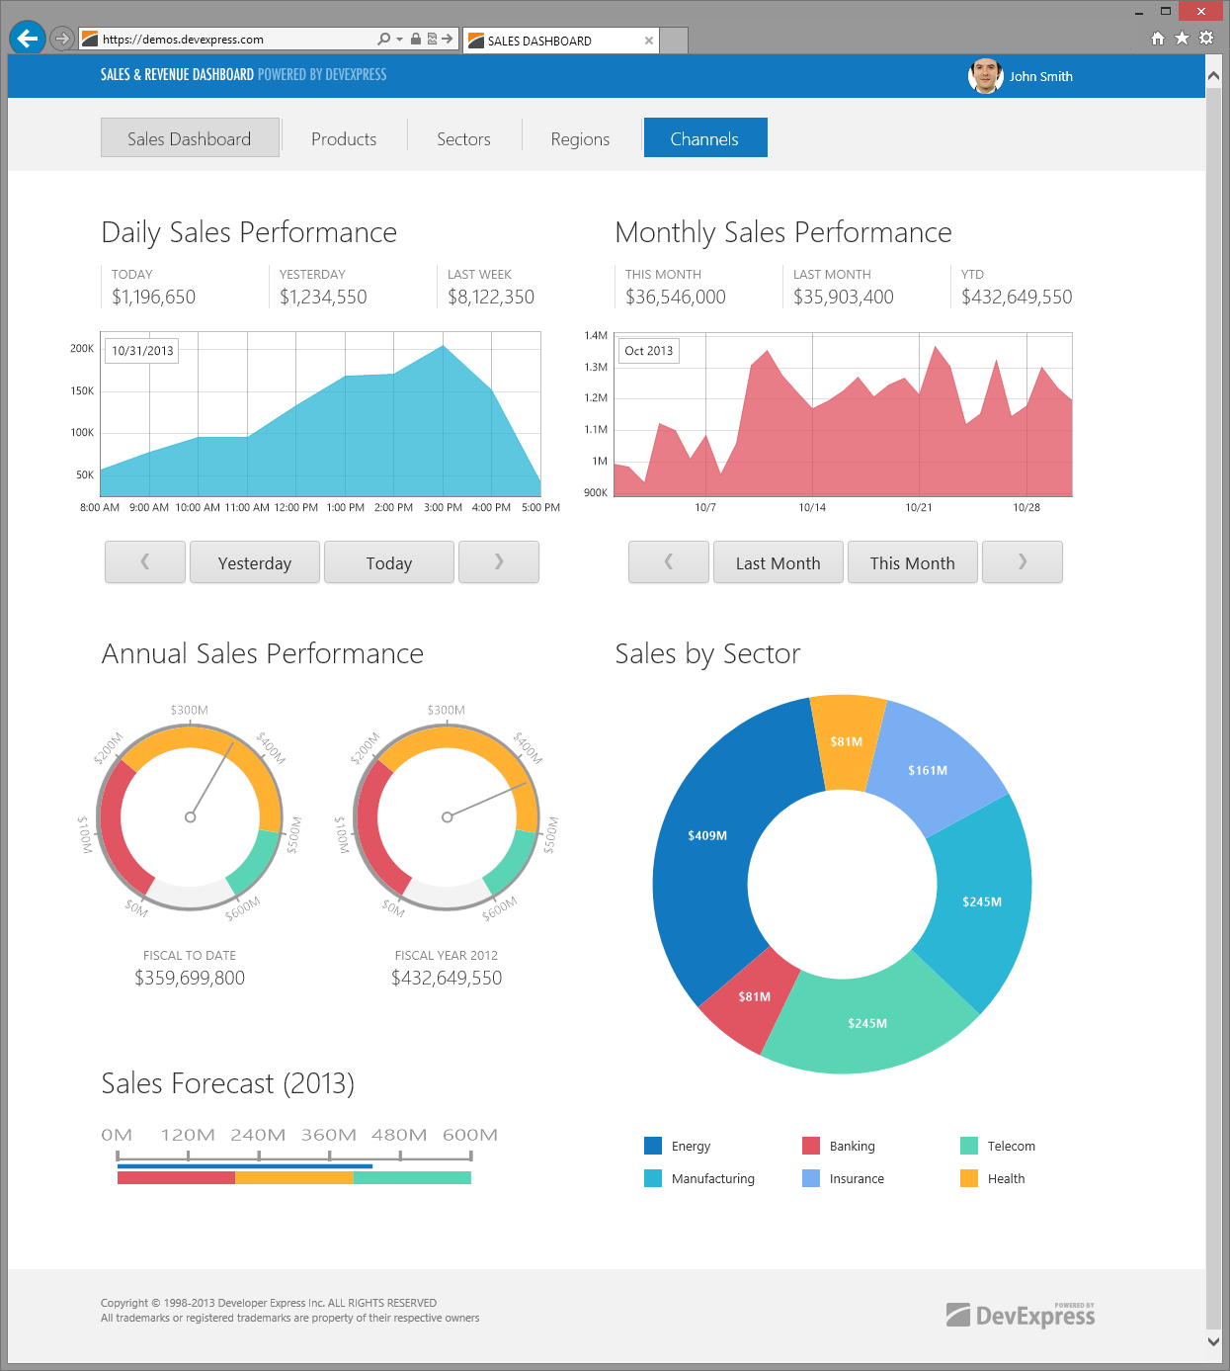
Other ASP.NET MVC Wrappers

Slide 23

DevExpress
.NET UI Controls for Developers of Mobile, Desktop, Web & Reporting Applications
ASP.NET MVC Wrappers
Grid View
Reporting
Charting
Editors
Themes
https://www.devexpress.com/Products/NET/Controls/ASP/MVC

Slide 24
MVC Controls Toolkit
Complete set of advanced server controls for MVC 2-5
Data Grid
Date picker
Text boxes
Client validation
Globalization
http://mvccontrolstoolkit.codeplex.com/

Slide 25
Summary
IgniteUI
KendoUI
DevExpress
MvcControlsToolkit

Slide 26









ASP.NET MVC Wrappers
https://softuni.bg/courses/asp-net-mvc/

Slide 27
License
This course (slides, examples, demos, videos, homework, etc.) is licensed under the "Creative Commons Attribution-NonCommercial-ShareAlike 4.0 International" license
Attribution: this work may contain portions from
"ASP.NET MVC" course by Telerik Academy under CC-BY-NC-SA license

Slide 28





Free Trainings @ Software University
Software University Foundation – softuni.org
Software University – High-Quality Education, Profession and Job for Software Developers
softuni.bg
Software University @ Facebook
facebook.com/SoftwareUniversity
Software University @ YouTube
youtube.com/SoftwareUniversity
Software University Forums – forum.softuni.bg

